Slide 1
RHS GIRLS SOCCER

Slide 2
MEET THE COACHES
Head Coach: Cori Bonte
Assistant Coach: Payton Pry
Volunteer Assistant: Danielle Thomas
Volunteer Assistant: Terry Hunter

Slide 3
Meet your trainers
Athletic Trainer: Scott Roggenbuck
Athletic Trainer: Alaina Klapperich
Strength and Conditioning Coach: Jordan Soukup

Slide 4
2022-2023 Parent Reps
Senior/Lead Parent Rep: Charisse Brockmueller
Junior Parent Rep: Sarah Fink
Sophomore Parent Rep: Misty Nelson
Freshman Parent Rep: Sarah Steffen

Slide 5
Student-athlete
Student-Athlete
Exactly that – No student – No soccer
Academic Eligibility
must be currently enrolled in 4 classes
must have passed a minimum of 4 classes/2.0 credits from the first semester
Grades will be checked every 2 weeks. Any athlete that has a D or F will be notified by their coach. She MUST meet with teacher before or after school within the week. Athlete will have 1 week after they meet with their teacher to make up work and or assignments. If progress is not made athlete will miss practice and/or games until progress has been made.
AD room and SRP (freshman and sophomores) occurs every day. This is an intervention time to work with teachers.
Coaches have the RIGHT to not allow your daughter to play if she cannot meet these expectations.

Slide 6
ABSENCE/TARDY POLICIES
If you are going to be late for practice, you must communicate ahead of time!
if you are going to miss a practice because of an illness, you must notify your coach before practice starts.
Ex: we have morning practice on Tuesday Morning. You are not feeling well Monday Night. You must contact your coach Monday night.
Ex: we have morning practice on Tuesday Morning. You wake up feeling sick Tuesday Morning. You must contact your coach at least a half hour before practice starts.
Leaving a message during practice is better than not at all.
Won’t accept any excuse after the event is over

Slide 7
PARENT EXPECTATIONS
help your daughter to understand the importance of communication, accountability, and being organized.
Being a part of something bigger than self, part of a team
Our goal is to provide a positive experience for all players-TEACH POSITIVITY
No parents at practice unless told otherwise
We may use various methods of reinforcement to try and get the most out of your daughter – if we yell it is b/c we need immediate correction. Everybody is accountable all the time
Provide positive support for your daughter and the team – discourage selfishness
Your attitude will be reflected in your daughter
Support decisions made by the coaching staff
Promote the importance of knowing and fulfilling roles – KEY TO OUR SUCCESS AS A PROGRAM
Referee shortage in our state. do your part and be kind!
When you blame other things (officials, coaches, conditions, circumstances, teammates) for the situation your daughter is in, then you’re essentially teaching your child how to be an excuse maker. set the standard. be the standard.

Slide 8
Parent GUIDELINES AND PROCEDURES FOR CONTACTING COACHES
Talk to your daughter about the issue first (it may not be a problem for her)
Step 1- Go to the coach your daughter is playing for
Step 2- If can not be resolved, will come to Coach Bonte’s attention
Step 3 If still no resolution – then we will bring to Administration
Things we will not discuss with you at any time
Playing time about your daughter (non-negotiable)
Playing time about someone else’s daughter
Coaching philosophy
Items we will discuss with parents
Academic performance
Attitude
Effort
Coachability
If you want to meet with us about any of these topics –
YOUR daughter WILL BE PRESENT AT THE MEETING
Find an appropriate time to discuss these with the coach’s staff
Not before or after a game (24 hour rule)
Not before or during Practice…Love to have an open line of communication with all parents throughout the entire year along these guidelines

Slide 9
SOCIAL MEDIA
As social media becomes more prevalent in our society, please be conscious of what you or your child is posting on social media. Collegiate coaches/recruiters and employers use social media to see what your child has posted when recruiting or hiring. It is a job interview all the time! Also remember, if it is not positive for our program, don’t press send.

Slide 10
MISC. ITEMS...
Lettering Policy:
Varsity Letters will be awarded for student athletes based on attendance, attitude and achievement. If a student athlete participates in a varsity contest and dedicates herself to the team and the practices, she will be awarded a letter. However, it is the coach’s discretion on whether or not this player earned a varsity letter throughout the season.
Inclement Weather Procedures
If the SFSD DOES Cancel or Early Dismiss, we CANNOT have a practice or rehearsal, this includes a voluntary practice or rehearsal of any kind. All students must go home.
If event is cancelled elsewhere and the SFSD DOES NOT Cancel or Early Dismiss, we may have a practice or a rehearsal.
If the SFSD has a late start and you have a practice or rehearsal scheduled for the morning, that practice or rehearsal will have to be moved to after school or cancelled.

Slide 11
Jersey Information
Shorts (white and cardinal), jerseys (white and cardinal, socks (white and cardinal) are provided to your daughters.
They will also get a bag and a long sleeve black half zip
At the end of the season ALL these items are to be turned back in besides the socks. You daughter will keep her socks.

Slide 12
FAN GEAR WEBSITE
https://daubyssportscenter.chipply.com/rhssoccer-girls/
The close date on the fan gear store is August 14th.
Your daughters will not get any other items with this logo so please order for them if they are interested.

Slide 13
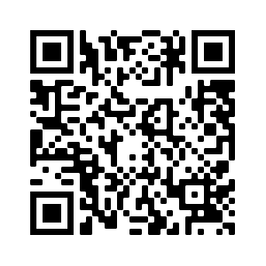
TRAVELING PERMISSION POLICY
Transportation (bussing) only is available when outside of city limits. If the game is being played inside city limits the student athletes are expected to drive or get a ride to the location.
If you wish you take your daughter to an away event or back home from an away event this form MUST be filled out. We HIGHLY encourage your daughters to ride the bus.
Link to fill out form can be found here: https://drive.google.com/file/d/1Tq7u44FX8oa4qitwOjsIy_XBY3svD-IS/view

Slide 14
HOW WE SHARE INFORMATION
Website Link: https://rhsgirlsoccer.weebly.com/
Twitter: @rhs_soccergirls
Facebook: Roosevelt Girls Soccer
Remind App:
Players code: @2022riders
Parents code: @2022rhspar
Parents and players code: @rhssoc

Slide 15
Upcoming Dates
Monday August 8th @7:00 (HUGE/MAIN fundraiser)
Call-A-Thon
This is something we have done the past two years and have had a lot of success!
Monday August 14th (evening)
Team and individual photos
Location: downtown (more information to come)
Misty Nelson is nice enough to do these for the team and she does a GREAT job!

Slide 16
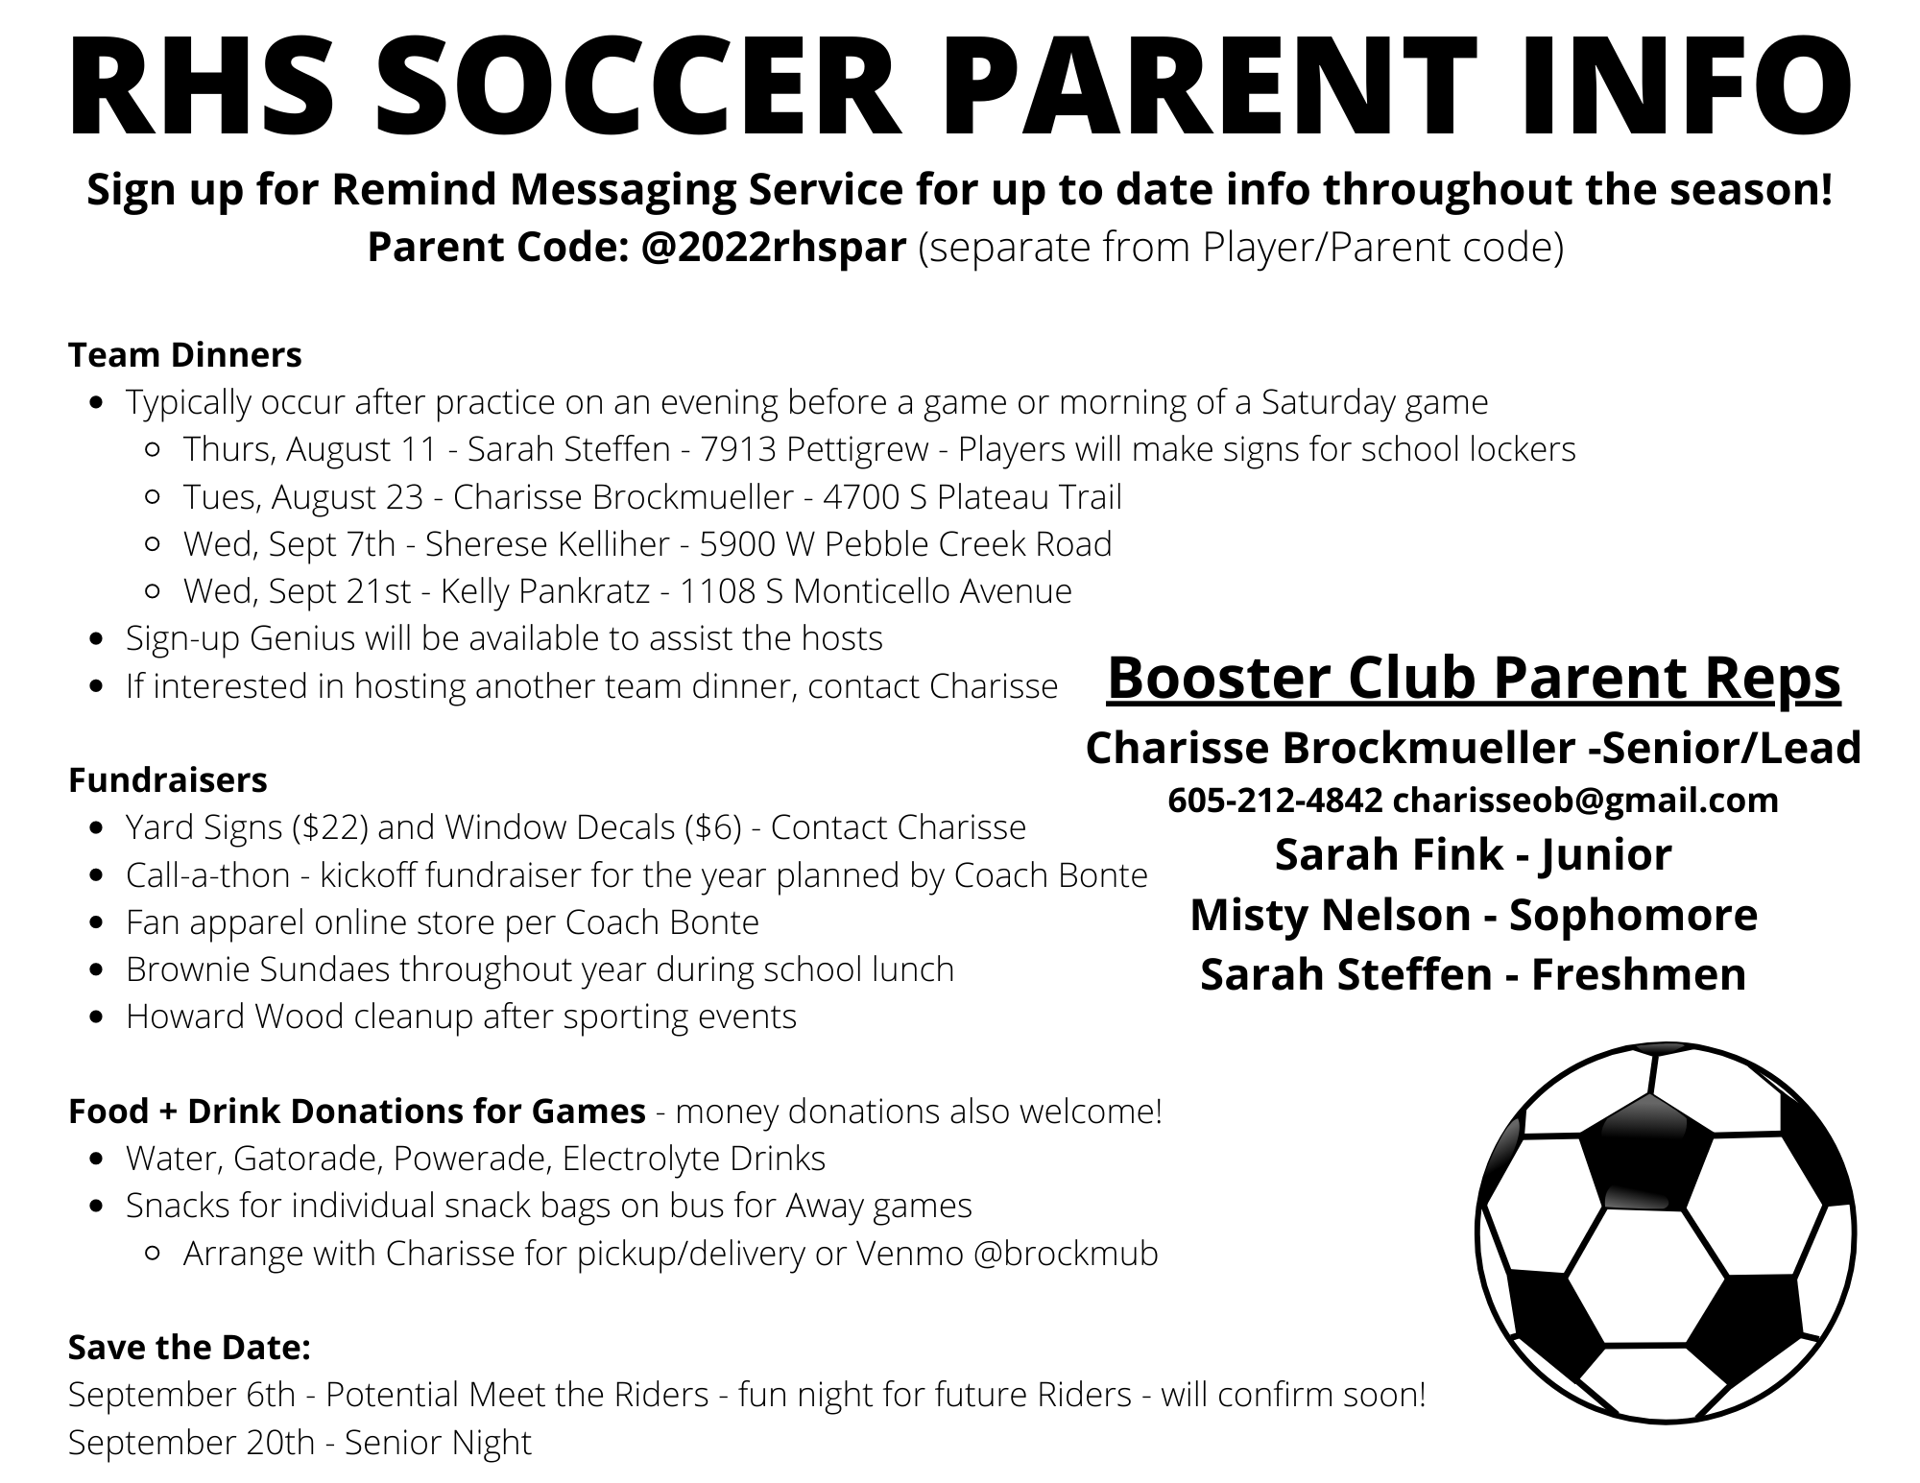

Slide 17
Questions
Email: corissa.bonte@k12.sd.us (Head Coach)
Email: steve.moore@k12.sd.us (Athletic Director)

Slide 18
